Slide 1

Control Flow

Slide 2
Before we start:
Any questions on Karel?

Slide 3
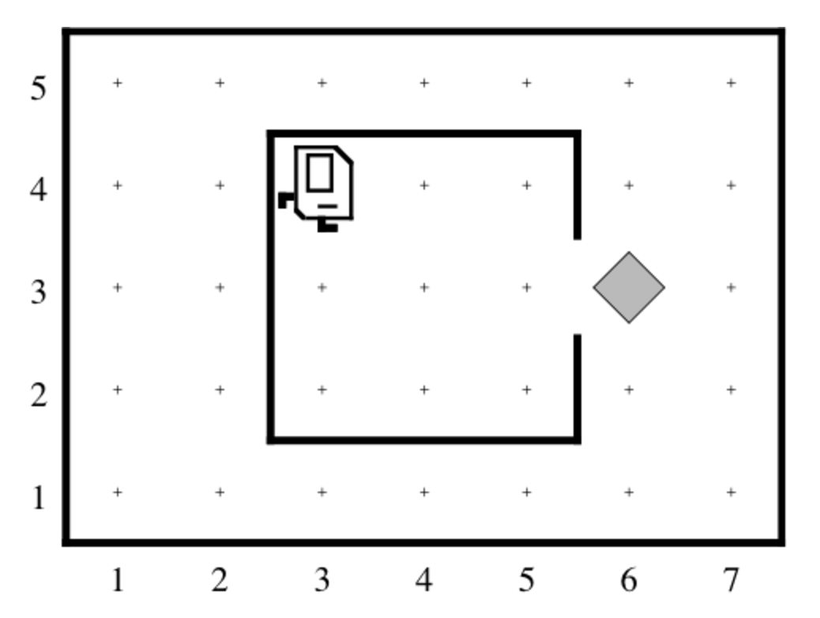
Newspaper Karel

Slide 4
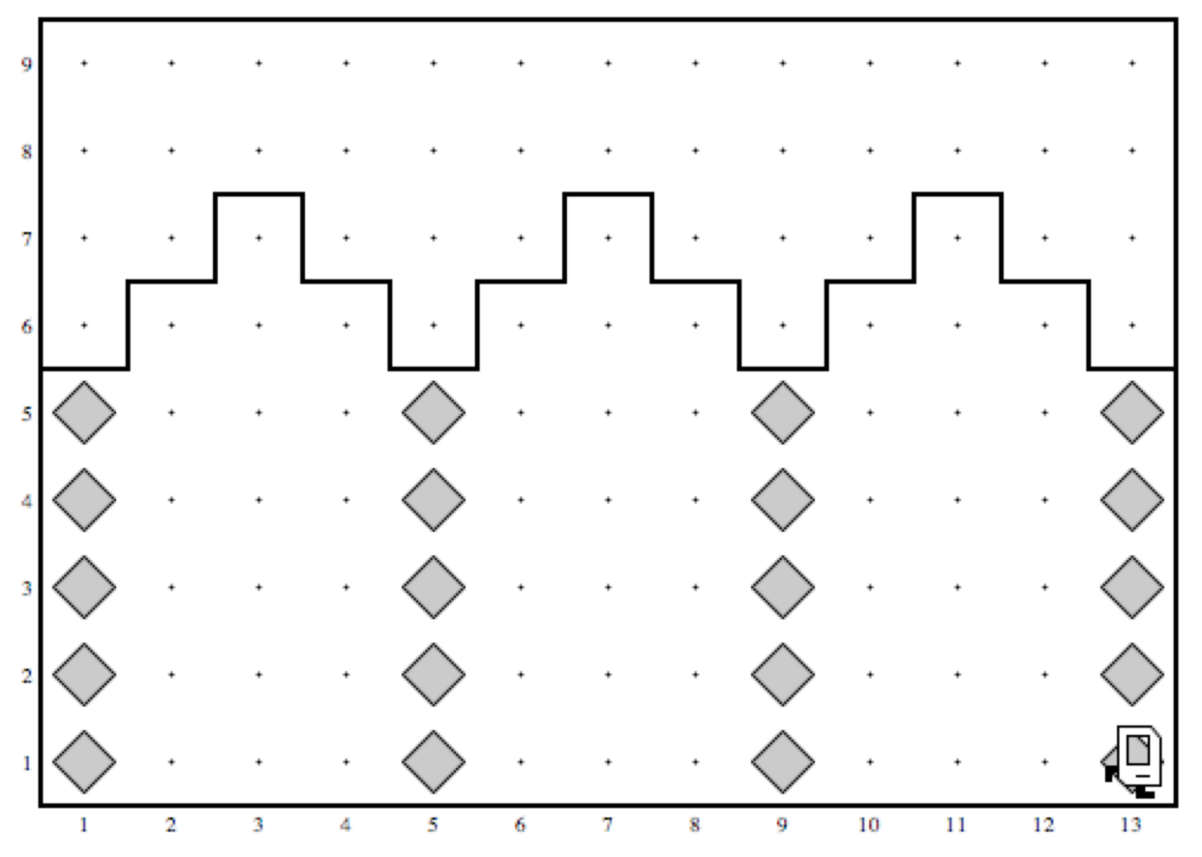
You know how to make Karel build Efes

Slide 5
That’s fun!...

Slide 6
…but a robot should get prepared for the dangers of the world

Slide 7
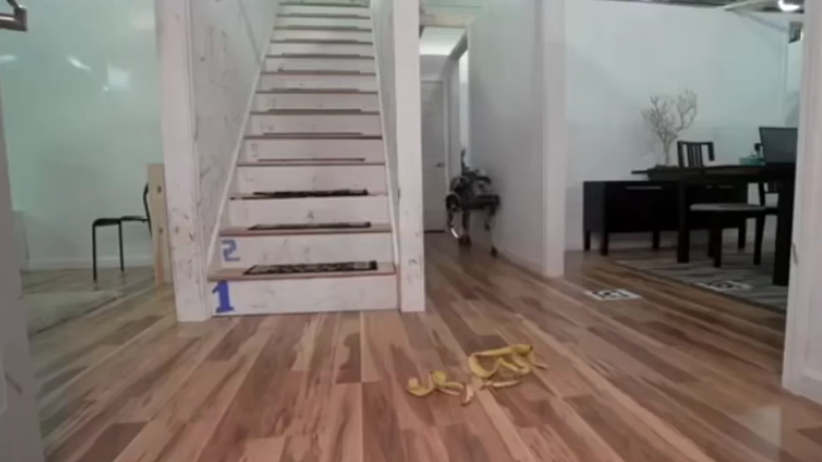

Slide 8
…awareness about the environment
would save lives

Slide 9
…awareness about the environment
would save lives
Karel should know how to:
…count the steps

Slide 10
…awareness about the environment
would save lives
Karel should know how to :
…count the steps
…check what’s around

Slide 11
…awareness about the environment
would save lives
Karel should know how to :
…count the steps
…check what’s around
…adjust to the environment

Slide 12
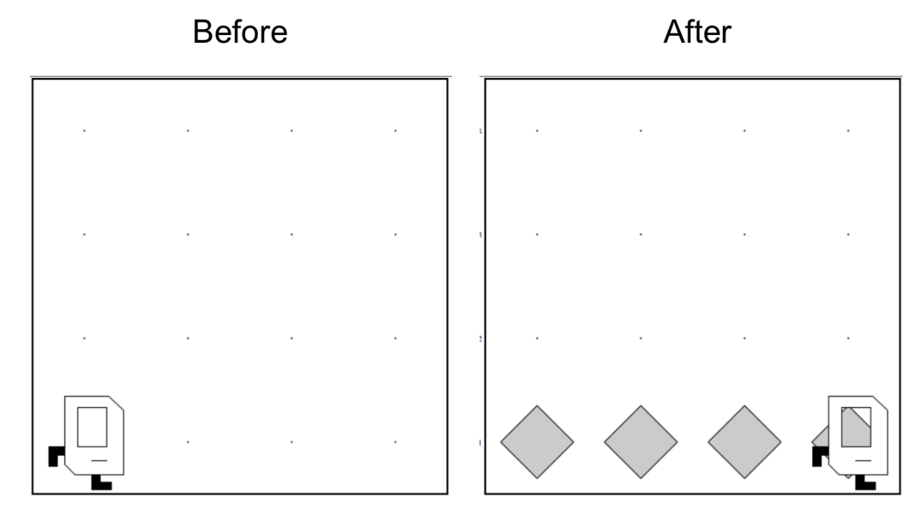
Place Beeper Line

Slide 13
Place Beeper Line
import stanford.karel.*;
public class BeeperLine extends SuperKarel {
public void run() {
for(int i = 0; i < 4; i++) {
putBeeper();
move();
}
}
}
Here is a code I want to try.
Would that do the job?

Slide 14

Place Beeper Line
import stanford.karel.*;
public class BeeperLine extends SuperKarel {
public void run() {
for(int i = 0; i < 4; i++) {
putBeeper();
move();
}
}
}

Slide 15
Place Beeper Line
import stanford.karel.*;
public class BeeperLine extends SuperKarel {
public void run() {
for(int i = 0; i < 4; i++) {
putBeeper();
move();
}
}
}

Slide 16
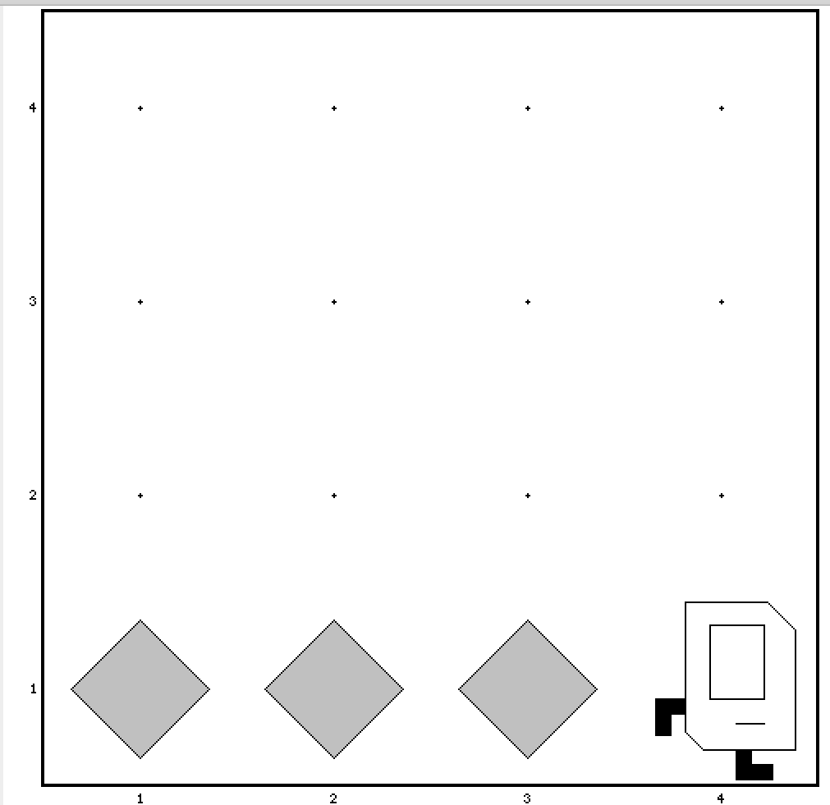
Place Beeper Line
import stanford.karel.*;
public class BeeperLine extends SuperKarel {
public void run() {
for(int i = 0; i < 3; i++) {
putBeeper();
move();
}
}
}

Slide 17

Place Beeper Line
import stanford.karel.*;
public class BeeperLine extends SuperKarel {
public void run() {
for(int i = 0; i < 3; i++) {
putBeeper();
move();
}
// extra put beeper
putBeeper();
}
}

Slide 18
Don’t Know World Size
?

Slide 19
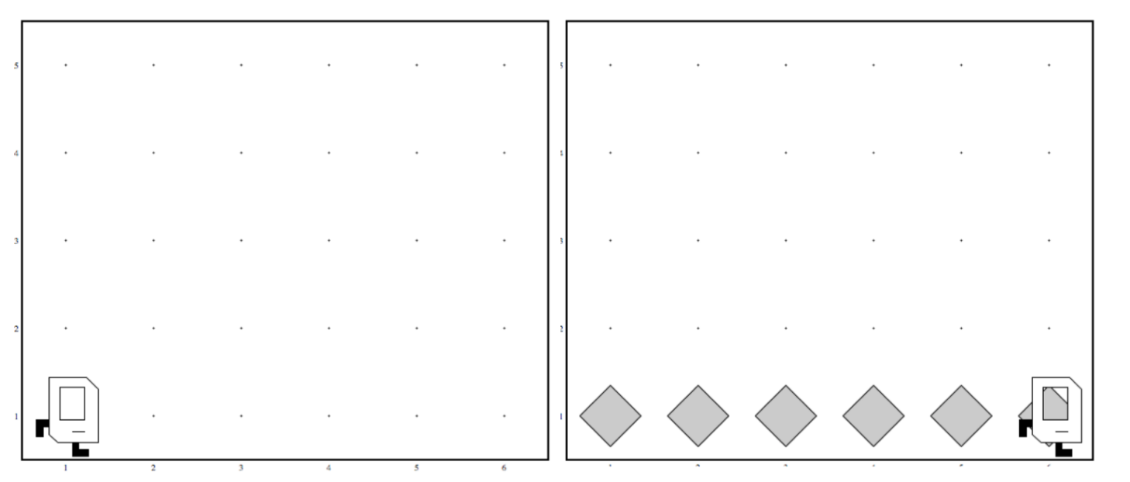
Work in Any World
Before
After
Before
After

Slide 20
While Loop

Slide 21
While Loop
import stanford.karel.*;
public class BeeperLine extends SuperKarel {
public void run() {
// example while loop
while(condition) {
code to repeat
}
}
}
Check the condition
True -> execute
Check the condition
True -> execute
….
Check the condition
False-> don’t execute.
Continue the rest of the program

Slide 22
Place Beeper Line
import stanford.karel.*;
public class BeeperLine extends SuperKarel {
public void run() {
// example while loop
while(frontIsClear()) {
move();
}
// extra put beeper
putBeeper();
}
}
Any guess what this code will do?
How should we modify it?

Slide 23
Place Beeper Line
import stanford.karel.*;
public class BeeperLine extends SuperKarel {
public void run() {
// example while loop
while(frontIsClear()) {
putBeeper();
move();
}
// extra put beeper
putBeeper();
}
}

Slide 24
Place Beeper Line
import stanford.karel.*;
public class BeeperLine extends SuperKarel {
public void run() {
// example while loop
while(frontIsClear()) {
putBeeper();
move();
}
// extra put beeper
putBeeper();
}
}

Slide 25
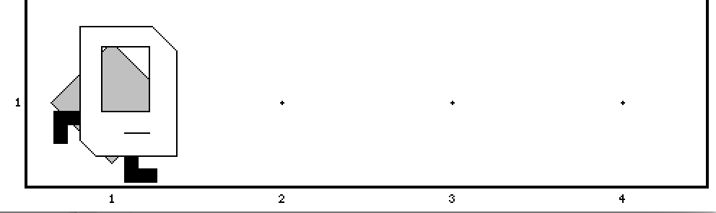
Place Beeper Line
import stanford.karel.*;
public class BeeperLine extends SuperKarel {
public void run() {
// example while loop
while(frontIsClear()) {
putBeeper();
move();
}
// extra put beeper
putBeeper();
}
}

Slide 26
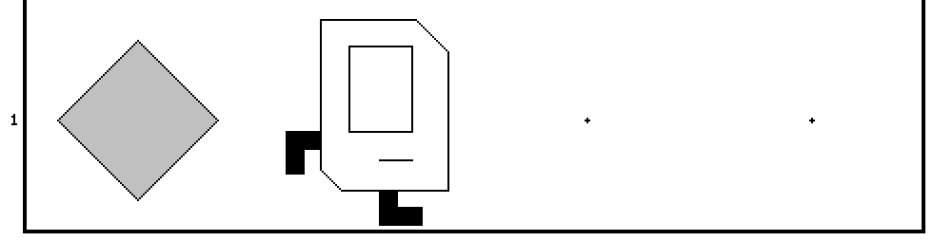
Place Beeper Line
import stanford.karel.*;
public class BeeperLine extends SuperKarel {
public void run() {
// example while loop
while(frontIsClear()) {
putBeeper();
move();
}
// extra put beeper
putBeeper();
}
}

Slide 27
Place Beeper Line
import stanford.karel.*;
public class BeeperLine extends SuperKarel {
public void run() {
// example while loop
while(frontIsClear()) {
putBeeper();
move();
}
// extra put beeper
putBeeper();
}
}

Slide 28
Place Beeper Line
import stanford.karel.*;
public class BeeperLine extends SuperKarel {
public void run() {
// example while loop
while(frontIsClear()) {
putBeeper();
move();
}
// extra put beeper
putBeeper();
}
}

Slide 29
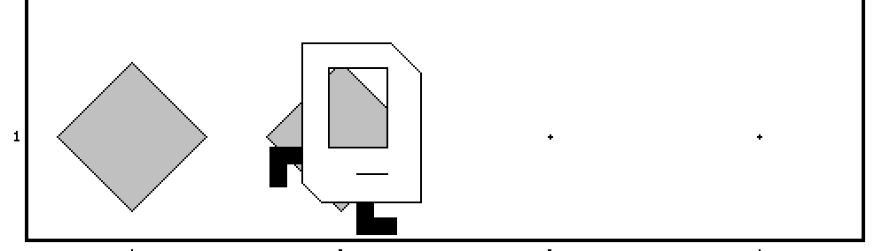
Place Beeper Line
import stanford.karel.*;
public class BeeperLine extends SuperKarel {
public void run() {
// example while loop
while(frontIsClear()) {
putBeeper();
move();
}
// extra put beeper
putBeeper();
}
}

Slide 30
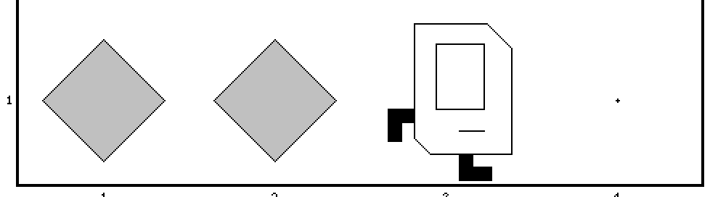
Place Beeper Line
import stanford.karel.*;
public class BeeperLine extends SuperKarel {
public void run() {
// example while loop
while(frontIsClear()) {
putBeeper();
move();
}
// extra put beeper
putBeeper();
}
}

Slide 31
Place Beeper Line
import stanford.karel.*;
public class BeeperLine extends SuperKarel {
public void run() {
// example while loop
while(frontIsClear()) {
putBeeper();
move();
}
// extra put beeper
putBeeper();
}
}

Slide 32
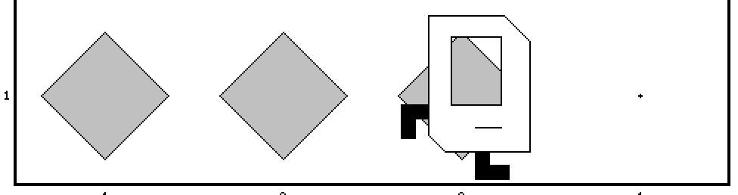
Place Beeper Line
import stanford.karel.*;
public class BeeperLine extends SuperKarel {
public void run() {
// example while loop
while(frontIsClear()) {
putBeeper();
move();
}
// extra put beeper
putBeeper();
}
}

Slide 33
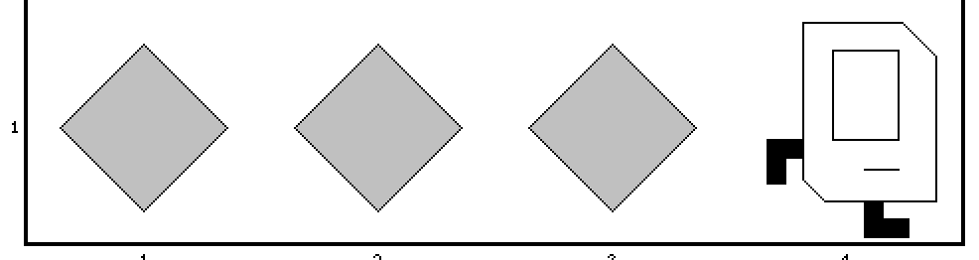
Place Beeper Line
import stanford.karel.*;
public class BeeperLine extends SuperKarel {
public void run() {
// example while loop
while(frontIsClear()) {
putBeeper();
move();
}
// extra put beeper
putBeeper();
}
}

Slide 34
Place Beeper Line
import stanford.karel.*;
public class BeeperLine extends SuperKarel {
public void run() {
// example while loop
while(frontIsClear()) {
putBeeper();
move();
}
// extra put beeper
putBeeper();
}
}

Slide 35
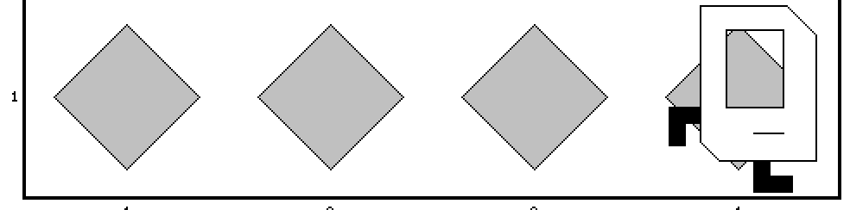
Place Beeper Line
import stanford.karel.*;
public class BeeperLine extends SuperKarel {
public void run() {
// example while loop
while(frontIsClear()) {
putBeeper();
move();
}
// extra put beeper
putBeeper();
}
}

Slide 36
Which Loop
Repeat Process
Know how many times
Don’t know how many times
For Loop
While Loop

Slide 37
What if you only want to repeat one time?

Slide 38
If statement

Slide 39
If Statement
import stanford.karel.*;
public class IfExample extends SuperKarel {
public void run() {
// example of an if statement
if(condition) {
code to run if condition is true
}
}
}

Slide 40
If Statement
import stanford.karel.*;
public class IfExample extends CSBridgeStudent{
public void run() {
// example of an if statement
if(youAreInCSBridge()) {
raiseYourHand();
}
}
}
Assume yourself as Karel and execute this program!

Slide 41
Let’s teach Karel to be more carefully and stop killing itself trying to go through the walls.
Could there be a safer way to move?

Slide 42
If Statement
import stanford.karel.*;
public class IfExample extends SuperKarel{
public void run() {
safeMove();
}
private void safeMove() {
if(frontIsClear()) {
move();
}
}
}

Slide 43
We can also specify what will happens if the condition is false

Slide 44
If else statement

Slide 45
Karel goes to the army:
If there is beeper take it
If there is no beeper put one
… silly? That’s the point!

Slide 46
If / Else Statement
import stanford.karel.*;
public class IfExample extends SuperKarel{
public void run() {
invertBeeper();
}
private void invertBeeper() {
if(beeperPresent()) {
pickBeeper();
} else {
putBeeper();
}
}
}

Slide 47
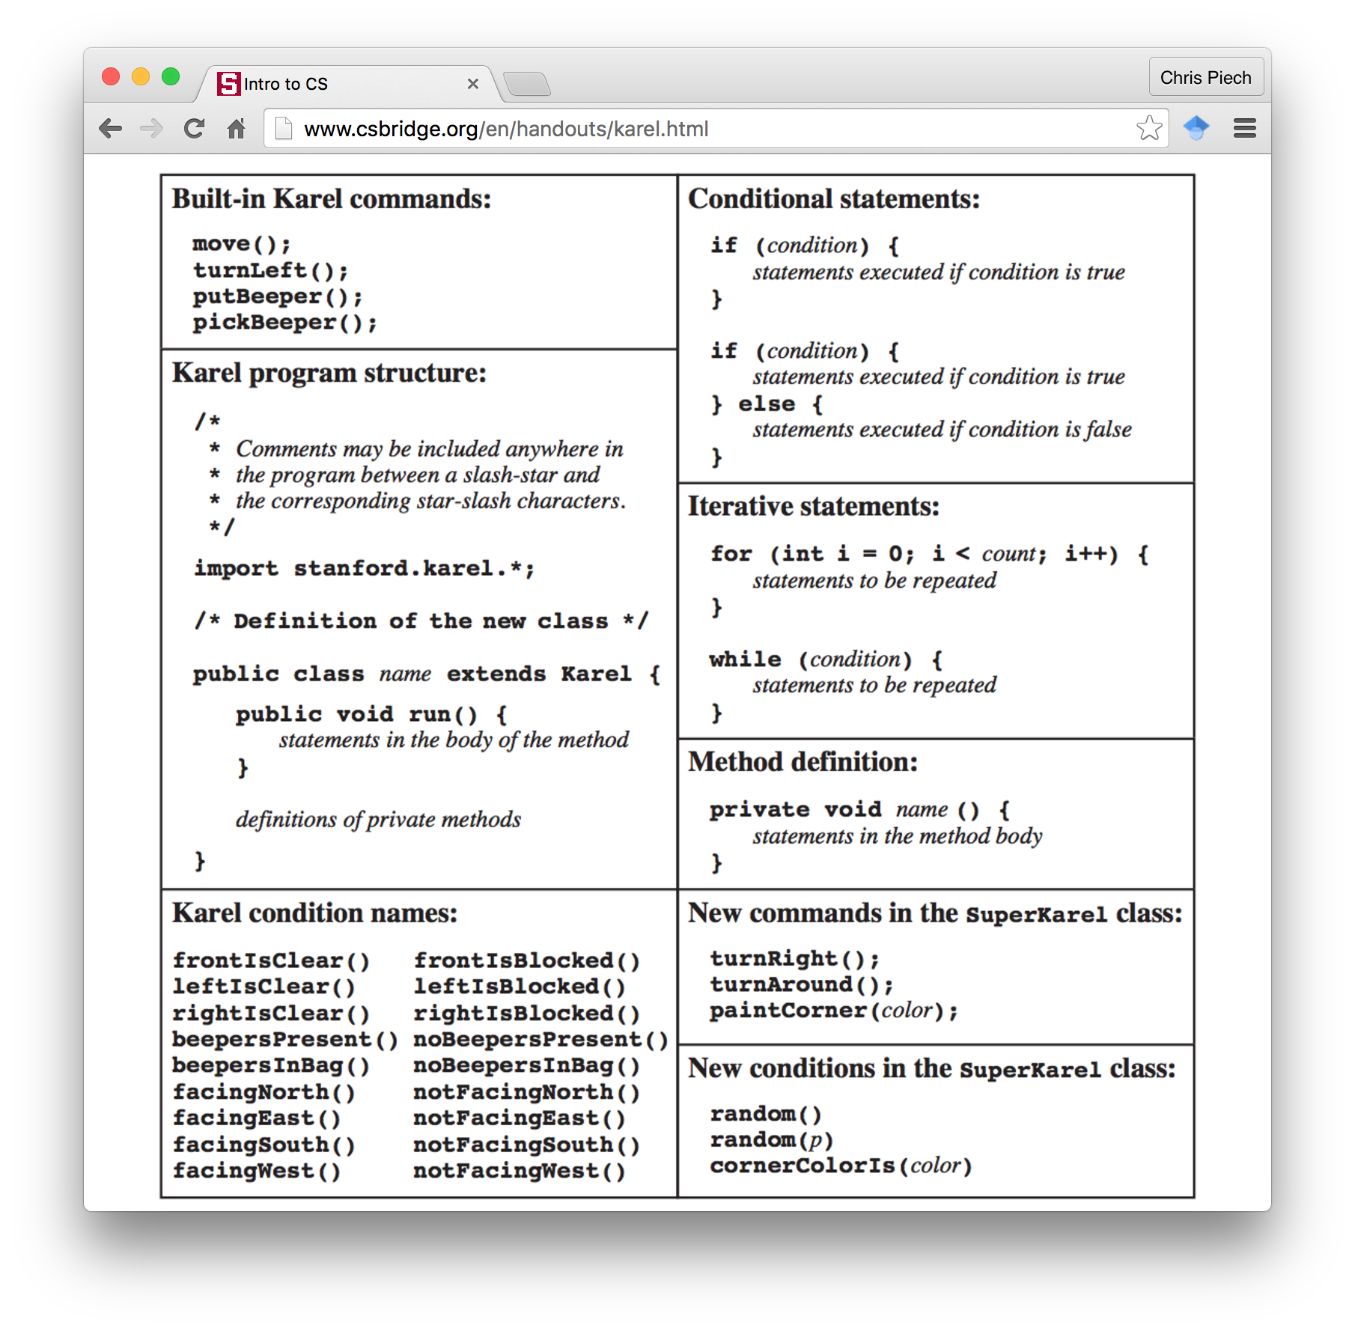
Karel Conditions

Slide 48
Your tasks this afternoon

Slide 49
1. Program Build Efes Karel

Slide 50
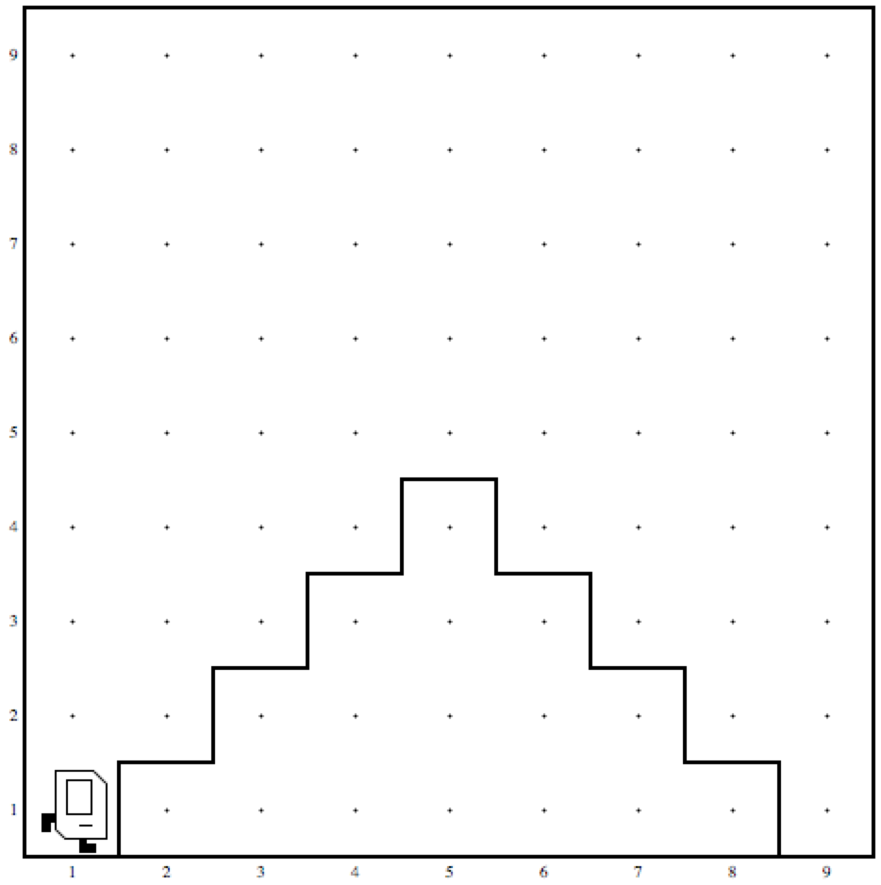
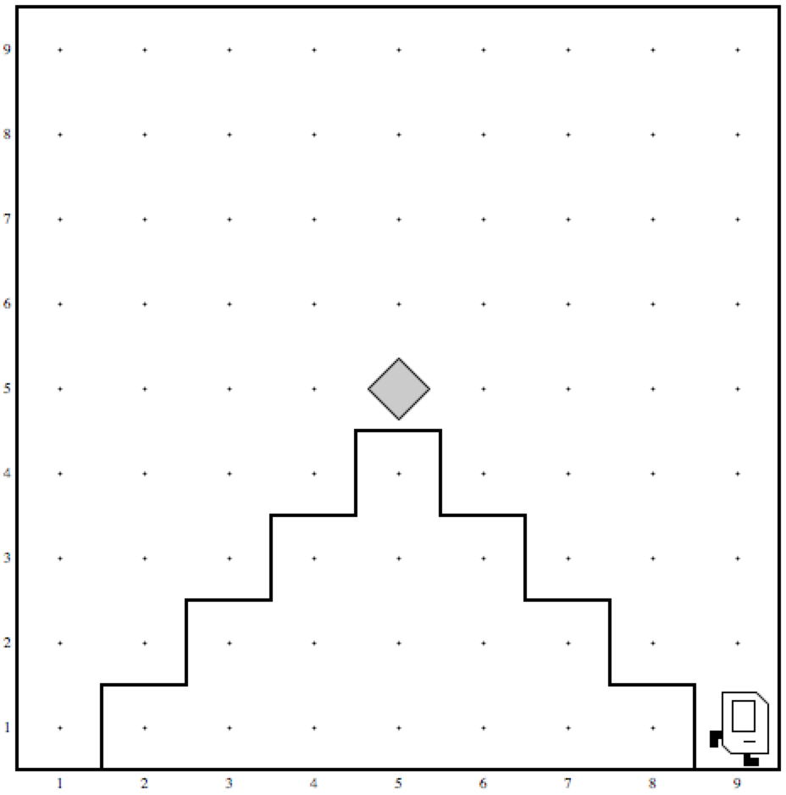
2. Mountain Karel
Before
After

Slide 51
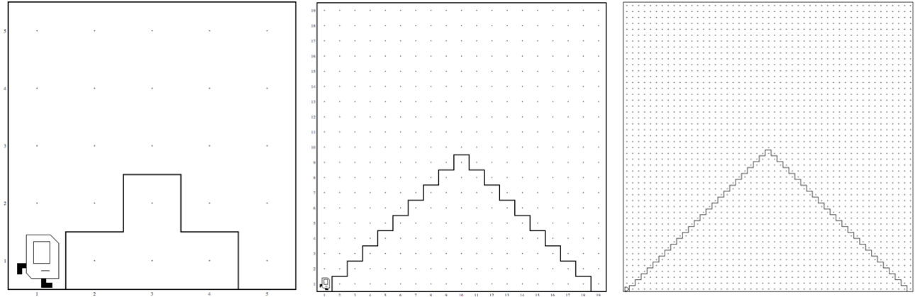
2. Mountain Karel
Should work on a world
of any size ☺

Slide 52
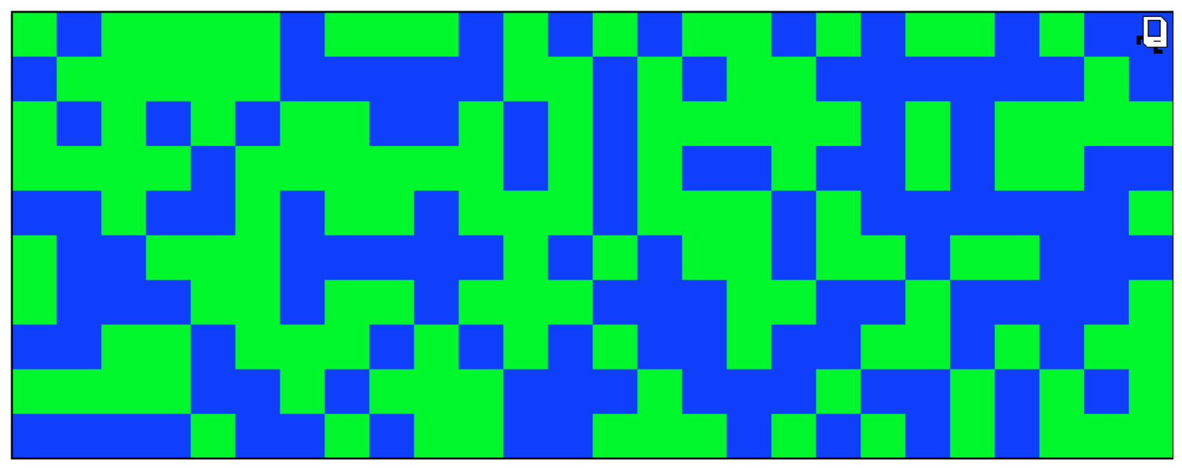
3. Random Painter

Slide 53
What if I finish early?

